Slide 1
Data Analytics using Python
(15 hours)
Notes:
Title - The learning outcome
Subtitle - Duration

Slide 2
In this section, we will discuss:
Multidimensional data handling using Pandas Library
Data Visualization using Matplotlib
Advanced data visualization using seaborn
Pandas profiling for report generation
Need for data visualization
Notes:
Mention the parent topics one by one. This particular learning outcome has 4 parent topics.

Slide 3

Multidimensional data handling using Pandas Library
What is PANDAS
PANDAS (PANel Data) is a high level data manipulation tool used for analysis data.
It is vary easy to import and export data using the Pandas library which has a very rich set of functions.
Image Source:https://cdn.educba.com/academy/wp-content/uploads/2019/04/What-is-Pandas-1.jpg
Notes:
Left (White Color space):
Title - Parent Topic
Subtitle - Subtopic 1
Body Text - Description in bullets
Right (Grey Color Space):
Body Text - Relevant image (with source)/code snippet
Put reference links in Speaker Notes
Reference:
https://www.tutorialspoint.com/internet_technologies/internet_overview.htm/

Slide 4
Multidimensional data handling using Pandas Library
What is PANDAS
Pandas have three important data structures, namely- Series, DataFrame, and Panel to make the process of analyzing data organized, effective and efficient.
Image Source:https://cdn.educba.com/academy/wp-content/uploads/2019/04/What-is-Pandas-1.jpg
Notes:
Left (White Color space):
Title - Parent Topic
Subtitle - Subtopic 1
Body Text - Description in bullets
Right (Grey Color Space):
Body Text - Relevant image (with source)/code snippet
Put reference links in Speaker Notes
Reference:
https://www.tutorialspoint.com/internet_technologies/internet_overview.htm/

Slide 5
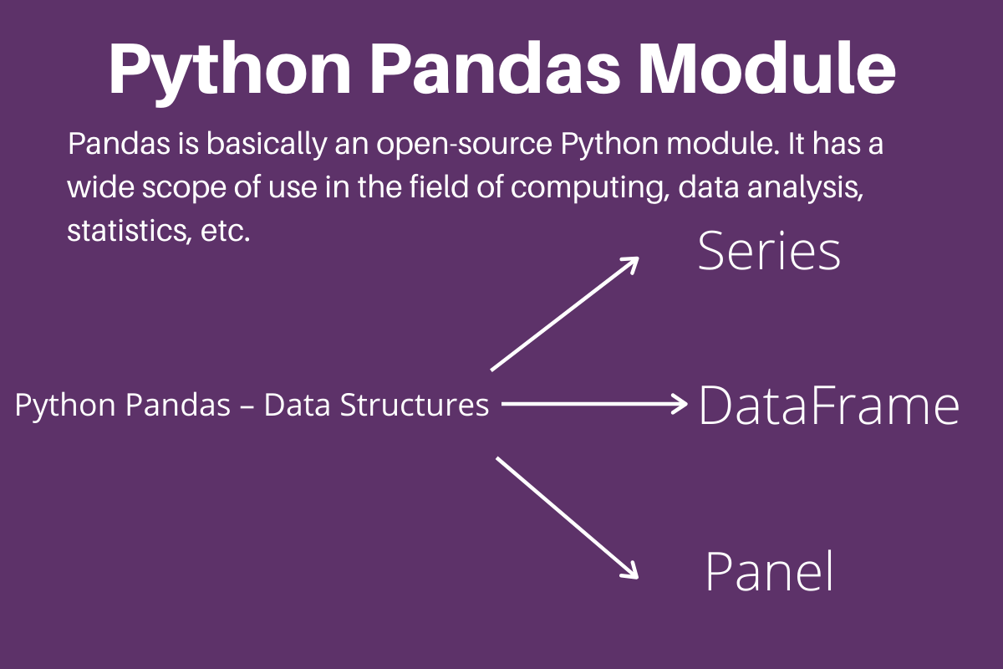
Multidimensional data handling using Pandas Library
Data Structure in Pandas
Pandas deals with 3 data structure
Series
Data Frame
Panel
Image Source: https://www.askpython.com/wp-content/uploads/2020/02/Python-Pandas-Module.png
Notes:
Left (White Color space):
Title - Parent Topic
Subtitle - Subtopic 1
Body Text - Description in bullets
Right (Grey Color Space):
Body Text - Relevant image (with source)/code snippet
Put reference links in Speaker Notes
Reference:
https://www.tutorialspoint.com/internet_technologies/internet_overview.htm/

Slide 6
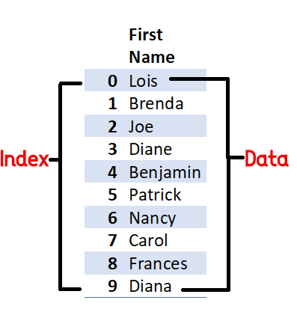
Multidimensional data handling using Pandas Library
Series
Series is a one-dimensional array like structure with homogeneous data, which can be used to handle and manipulate data.
Image Source:https://1.bp.blogspot.com/-mYFbQb6dNWo/Xyq3MiVrWMI/AAAAAAAAsB8/ayRGqtckDEIyctuow7M65ezNtMIdqeH7ACPcBGAYYCw/s437/Pandas%2Bseries.png
Notes:
Left (White Color space):
Title - Parent Topic
Subtitle - Subtopic 1
Body Text - Description in bullets
Right (Grey Color Space):
Body Text - Relevant image (with source)/code snippet
Put reference links in Speaker Notes
Reference:
https://www.tutorialspoint.com/internet_technologies/internet_overview.htm/

Slide 7
Multidimensional data handling using Pandas Library
Series
It has two parts
Data part (An array of actual data)
Associated index with data (associated array of indexes or data labels)
Image Source:https://1.bp.blogspot.com/-mYFbQb6dNWo/Xyq3MiVrWMI/AAAAAAAAsB8/ayRGqtckDEIyctuow7M65ezNtMIdqeH7ACPcBGAYYCw/s437/Pandas%2Bseries.png
Notes:
Left (White Color space):
Title - Parent Topic
Subtitle - Subtopic 1
Body Text - Description in bullets
Right (Grey Color Space):
Body Text - Relevant image (with source)/code snippet
Put reference links in Speaker Notes
Reference:
https://www.tutorialspoint.com/internet_technologies/internet_overview.htm/

Slide 8
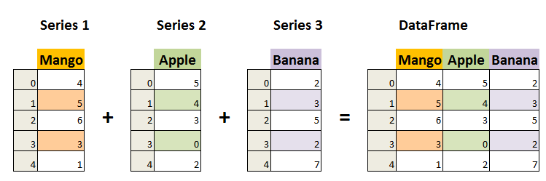
Multidimensional data handling using Pandas Library
Creation of Series
There are different ways in which a series can be created in Pandas.
Creation of Series from Scalar Values
Creation of Series from NumPy Arrays
Creation of Series from Dictionary
Image Source: https://www.datasciencemadesimple.com/wp-content/uploads/2020/05/create-series-in-python-pandas-0.png
Notes:
Left (White Color space):
Title - Parent Topic
Subtitle - Subtopic 1
Body Text - Description in bullets
Right (Grey Color Space):
Body Text - Relevant image (with source)/code snippet
Put reference links in Speaker Notes
Reference:
https://www.tutorialspoint.com/internet_technologies/internet_overview.htm/

Slide 9
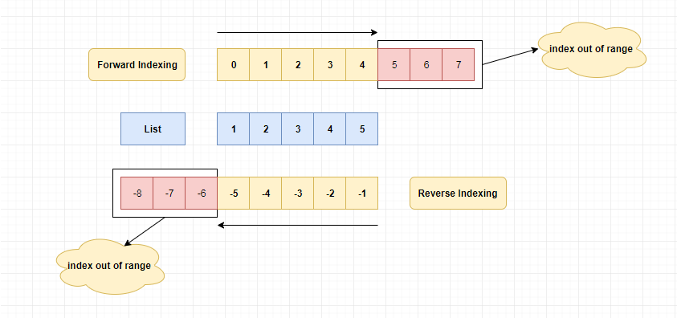
Multidimensional data handling using Pandas Library
Accessing Elements of a Series
There are two common ways for accessing the elements of a series: Indexing and Slicing.
Indexing
Slicing
Image Source: https://www.log2base2.com/images/general/python-list-index.png
Notes:
Left (White Color space):
Title - Parent Topic
Subtitle - Subtopic 1
Body Text - Description in bullets
Right (Grey Color Space):
Body Text - Relevant image (with source)/code snippet
Put reference links in Speaker Notes
Reference:
https://www.tutorialspoint.com/internet_technologies/internet_overview.htm/

Slide 10
Accessing Elements of a Series
Indexing
Indexing in Series is similar to that for NumPy arrays, and is used to access elements in a series.
Indexes are of two types: positional index and labelled index.
Positional index takes an integer value that corresponds to its position in the series starting from 0, whereas labelled index takes any user-defined label as index.
Image Source: https://www.log2base2.com/images/general/python-list-index.png
Notes:
Left (White Color space):
Title - Parent Topic
Subtitle - Subtopic 1
Body Text - Description in bullets
Right (Grey Color Space):
Body Text - Relevant image (with source)/code snippet
Put reference links in Speaker Notes
Reference:
https://www.tutorialspoint.com/internet_technologies/internet_overview.htm/

Slide 11
Accessing Elements of a Series
Slicing
Sometimes, we may need to extract a part of a series.
This can be done through slicing. This is similar to slicing used with NumPy arrays.
We can define which part of the series is to be sliced by specifying the start and end parameters [start :end] with the series name.
Image Source: https://www.log2base2.com/images/general/python-list-index.png
Notes:
Left (White Color space):
Title - Parent Topic
Subtitle - Subtopic 1
Body Text - Description in bullets
Right (Grey Color Space):
Body Text - Relevant image (with source)/code snippet
Put reference links in Speaker Notes
Reference:
https://www.tutorialspoint.com/internet_technologies/internet_overview.htm/

Slide 12
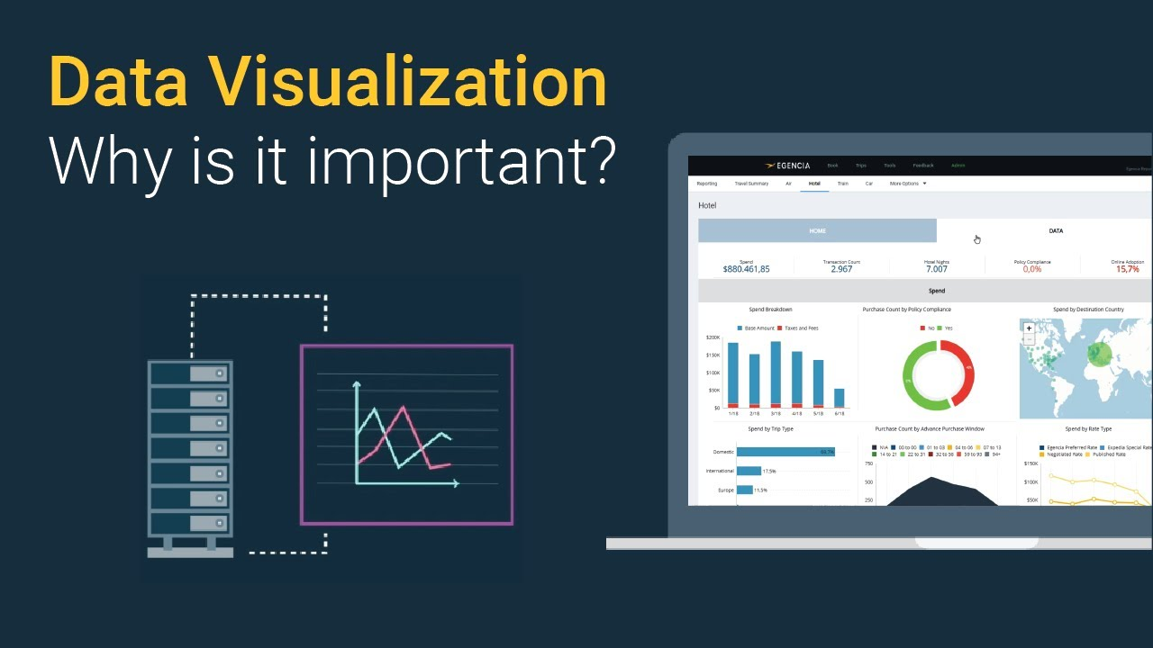
Data Visualization using Matplotlib
Why are visualizations important?
Visualizations are the easiest way to analyze and absorb information.
Visuals help to easily understand the complex problem.
They help in identifying patterns, relationships, and outliers in data.
Image Source:https://i.ytimg.com/vi/VyhLRJVoIrI/maxresdefault.jpg
Notes:
This slide talks about the case if we have to divide a subtopic further.
Title Box - Parent Topic
Subtitle box - Sub Topic
Body Text - Subtopic divisions (Subtopics of subtopics)

Slide 13
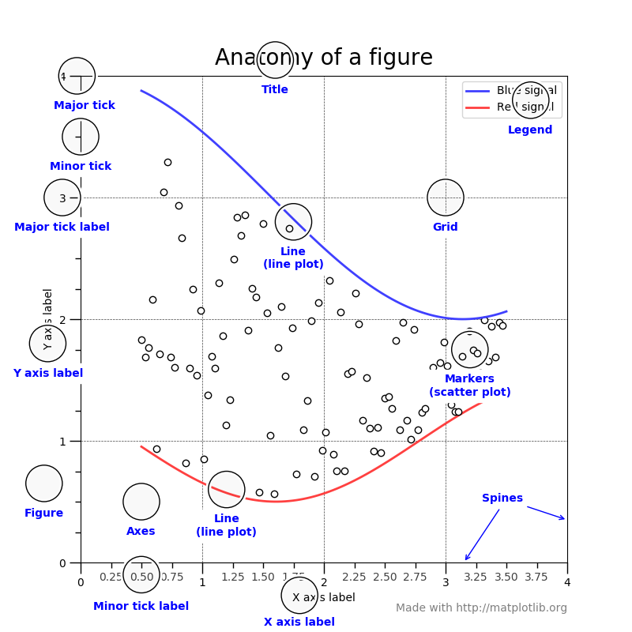
Data Visualization using Matplotlib
Matplotlib
Matplotlib is a 2-D plotting library that helps in visualizing figures.
Matplotlib emulates Matlab like graphs and visualizations.
Matlab is not free, is difficult to scale and as a programming language is tedious.
Image Source: https://matplotlib.org/3.1.1/_images/sphx_glr_anatomy_001.png
Notes:
This slide talks about the case if we have to divide a subtopic further.
Title Box - Parent Topic
Subtitle box - Sub Topic
Body Text - Subtopic divisions (Subtopics of subtopics)

Slide 14
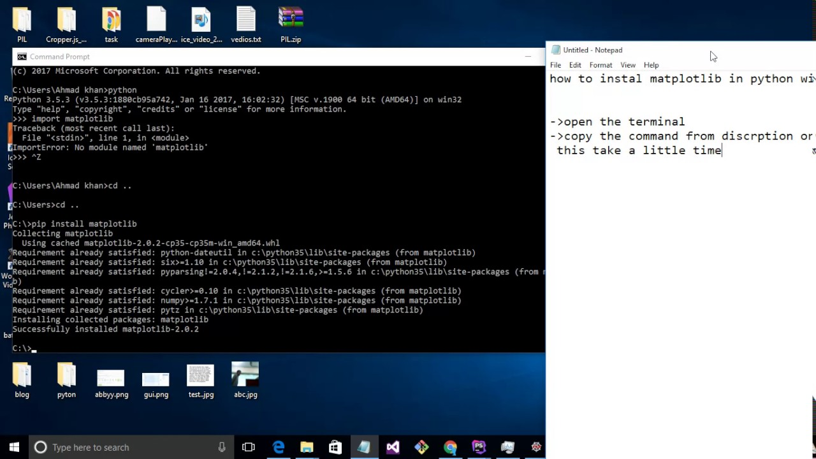
Data Visualization using Matplotlib
Installing Matplotlib
Type !pip install matplotlib in the Jupyter Notebook or if it doesn’t work in cmd type conda install -c conda-forge matplotlib .
This should work in most cases.
Image Source:https://i.ytimg.com/vi/Iq9f2bQJOPg/maxresdefault.jpg
Notes:
This slide talks about the case if we have to divide a subtopic further.
Title Box - Parent Topic
Subtitle box - Sub Topic
Body Text - Subtopic divisions (Subtopics of subtopics)

Slide 15
Data Visualization using Matplotlib
Things to follow
Plotting of Matplotlib is quite easy. Generally, while plotting they follow the same steps in each and every plot.
Matplotlib has a module called pyplot which aids in plotting figure.
The Jupyter notebook is used for running the plots.
Image Source:https://i.ytimg.com/vi/Iq9f2bQJOPg/maxresdefault.jpg
Notes:
This slide talks about the case if we have to divide a subtopic further.
Title Box - Parent Topic
Subtitle box - Sub Topic
Body Text - Subtopic divisions (Subtopics of subtopics)

Slide 16
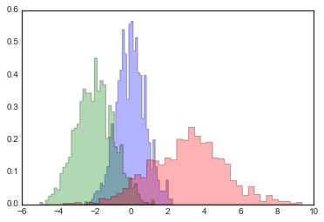
Data Visualization using Matplotlib
Histogram
A histogram takes in a series of data and divides the data into a number of bins.
It then plots the frequency data points in each bin (i.e. the interval of points).
It is useful in understanding the count of data ranges.
Image Source:https://i.stack.imgur.com/TBlN1.png
Notes:
This slide talks about the case if we have to divide a subtopic further.
Title Box - Parent Topic
Subtitle box - Sub Topic
Body Text - Subtopic divisions (Subtopics of subtopics)

Slide 17
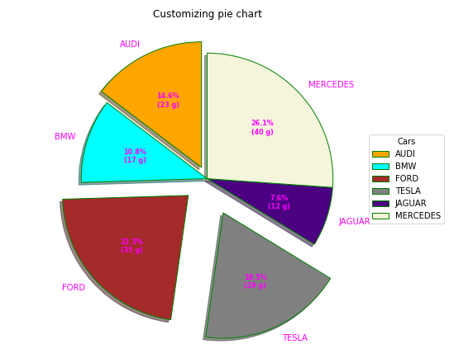
Data Visualization using Matplotlib
Histogram: Pie chart
It is a circular plot which is divided into slices to illustrate numerical proportion. The slice of a pie chart is to show the proportion of parts out of a whole.
When to use: Pie chart should be used seldom used as It is difficult to compare sections of the chart. Bar plot is used instead as comparing sections is easy.
Image Source:https://media.geeksforgeeks.org/wp-content/uploads/20200426195330/plot28.png
Notes:
This slide talks about the case if we have to divide a subtopic further.
Title Box - Parent Topic
Subtitle box - Sub Topic
Body Text - Subtopic divisions (Subtopics of subtopics)

Slide 18
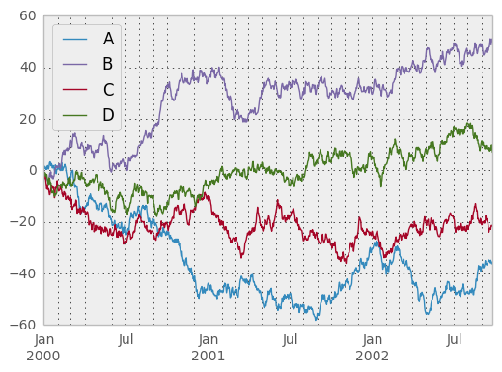
Data Visualization using Matplotlib
Time Series by line plot
Time series is a line plot and it is basically connecting data points with a straight line.
It is useful in understanding the trend over time.
It can explain the correlation between points by the trend.
An upward trend means positive correlation and downward trend means a negative correlation.
Image Source: https://pandas.pydata.org/pandas-docs/version/0.14.0/_images/frame_plot_basic.png
Notes:
This slide talks about the case if we have to divide a subtopic further.
Title Box - Parent Topic
Subtitle box - Sub Topic
Body Text - Subtopic divisions (Subtopics of subtopics)

Slide 19
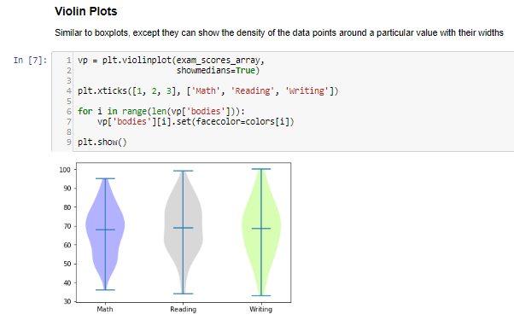
Data Visualization using Matplotlib
Time Series by line plot
Violin plot is a better chart than boxplot as it gives a much broader understanding of the distribution.
It resembles a violin and dense areas point the more distribution of data otherwise hidden by box plots
Image Source:https://miro.medium.com/max/1204/1*J9OnuX8f5BjlB3XZiyHkVA.png
Notes:
This slide talks about the case if we have to divide a subtopic further.
Title Box - Parent Topic
Subtitle box - Sub Topic
Body Text - Subtopic divisions (Subtopics of subtopics)

Slide 20
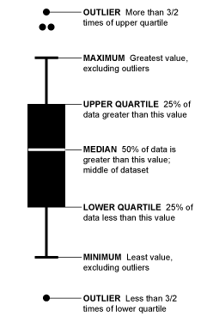
Boxplot and Violinplot
Boxplot
Boxplot gives a nice summary of the data.
It helps in understanding our distribution better.
Image Source:https://miro.medium.com/max/482/1*fCE_5juz235c6cmaOP_PDQ.png
Notes:
This slide talks about the case if we have to divide a subtopic further.
Title Box - Parent Topic
Subtitle box - Sub Topic
Body Text - Subtopic divisions (Subtopics of subtopics)

Slide 21
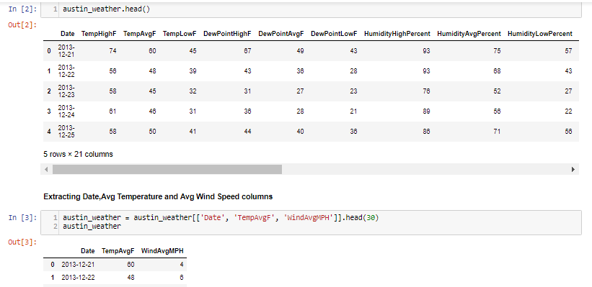
Data Visualization using Matplotlib
TwinAxis
TwinAxis helps in visualizing plotting 2 plots w.r.t to the y-axis and same x-axis.
Image Source: https://miro.medium.com/max/1400/1*dHwnU6ySte5aqNZYezQAgQ.png
Notes:
This slide talks about the case if we have to divide a subtopic further.
Title Box - Parent Topic
Subtitle box - Sub Topic
Body Text - Subtopic divisions (Subtopics of subtopics)

Slide 22
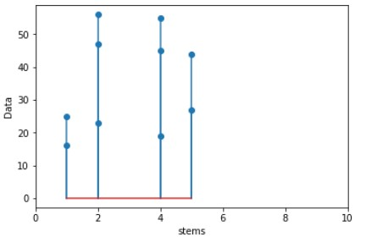
Data Visualization using Matplotlib
Stack Plot and Stem Plot
Stack plot visualizes data in stacks and shows the distribution of data over time.
Stemplot even takes negative values, so the difference is taken of data and is plotted over time.
Image Source:https://media.geeksforgeeks.org/wp-content/uploads/20190429193409/plt.jpg
Notes:
Continuing from the last slide:
Title - Subtopic
Subtitle - Subtopic of Subtopic
Body - Description

Slide 23
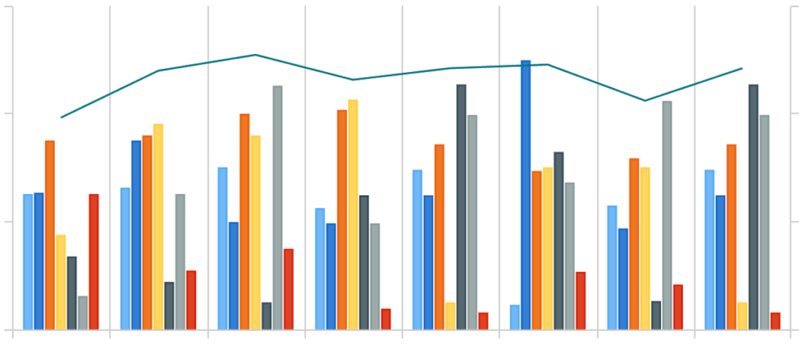
Data Visualization using Matplotlib
Bar Plot
Bar Plot shows the distribution of data over several groups.
It is commonly confused with a histogram which only takes numerical data for plotting.
It helps in comparing multiple numeric values.
Image Source:https://shanelynnwebsite-mid9n9g1q9y8tt.netdna-ssl.com/wp-content/uploads/2020/04/data-visualisation-bar-charts-in-python-pandas-1-1024x441.png
Notes:
Continuing from the last slide:
Title - Subtopic
Subtitle - Subtopic of Subtopic
Body - Description

Slide 24
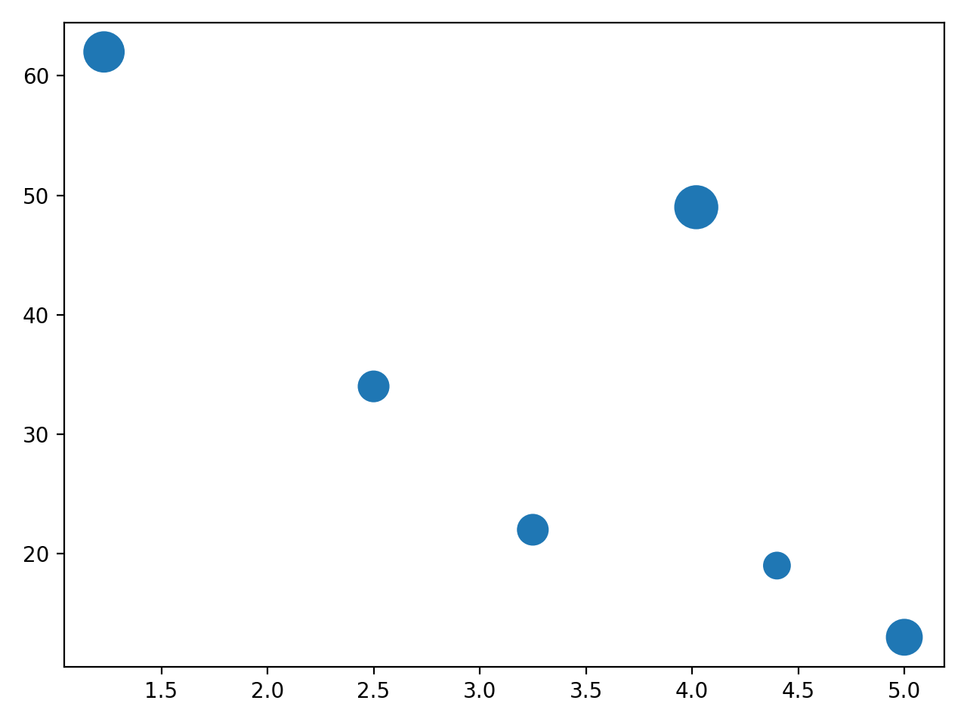
Data Visualization using Matplotlib
Scatter Plot
Scatter plot helps in visualizing 2 numeric variables.
It helps in identifying the relationship of the data with each variable i.e correlation or trend patterns.
It also helps in detecting outliers in the plot.
Image Source:https://files.realpython.com/media/scatter_plot_drinks_2.715371f88408.png
Notes:
Continuing from the last slide:
Title - Subtopic
Subtitle - Subtopic of Subtopic
Body - Description

Slide 25
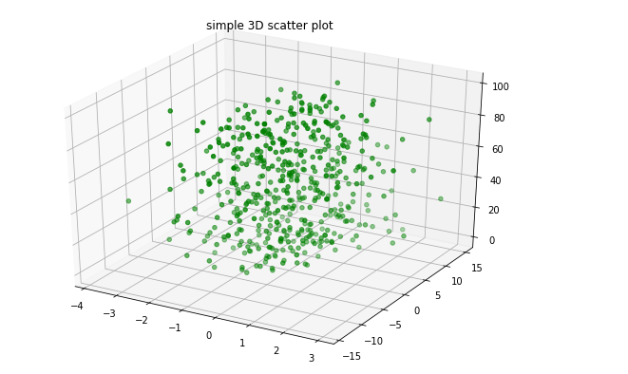
Data Visualization using Matplotlib
3D Scatterplot
3D Scatterplot helps in visualizing 3 numerical variables in a three- dimensional plot.
Image Source:https://media.geeksforgeeks.org/wp-content/uploads/20200504194233/plot119.png
Notes:
Continuing from the last slide:
Title - Subtopic
Subtitle - Subtopic of Subtopic
Body - Description

Slide 26
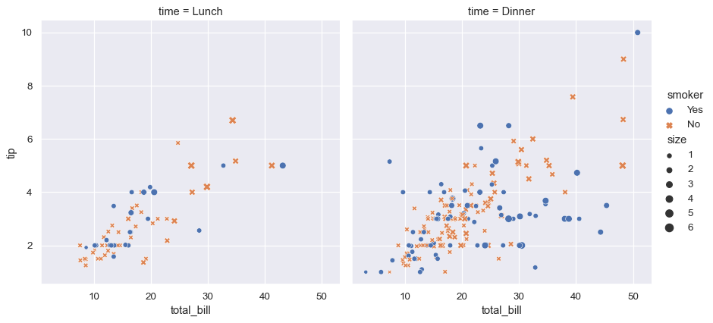
Advanced data visualization using seaborn
What is Seaborn?
Matplotlib is the king of Python data visualization libraries and makes it a breeze to explore tabular data visually.
Seaborn is another Python data visualization library built on top of Matplotlib that introduces some features that weren’t previously available, and, in this tutorial, we’ll use Seaborn.
Image Source: https://seaborn.pydata.org/_images/introduction_1_0.png
Notes:
Continuing from the last slide:
Title - Subtopic
Subtitle - Subtopic of Subtopic
Body - Description

Slide 27
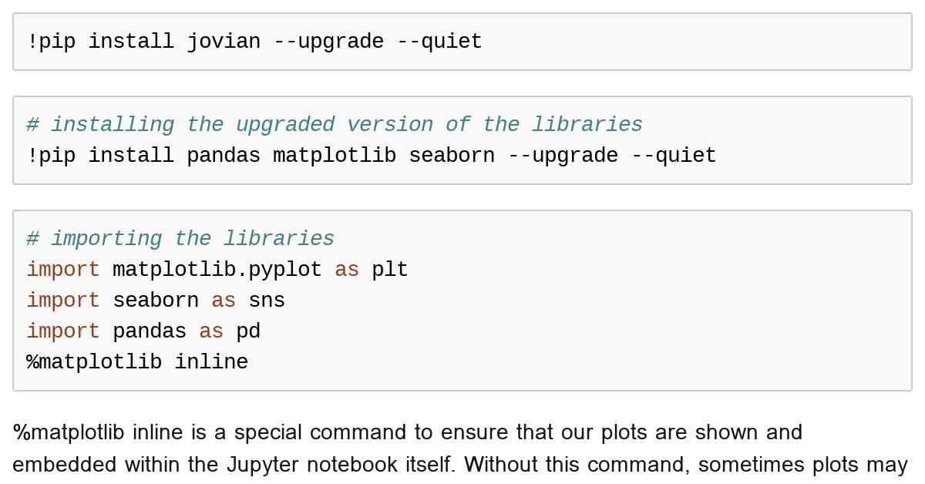
Advanced data visualization using seaborn
Installing the libraries and loading the data
We will start by installing the libraries and importing our data. Running the below command will install the Pandas, Matplotlib, and Seaborn libraries for data visualization:
pip install pandas matplotlib seaborn
Image Source: https://jovian.ai/api/gist/0503237bdcde46c4bd46c58843edf06b/preview/c9e3b2b3739a42c8b1298e3fb281d1af
Notes:
Continuing from the last slide:
Title - Subtopic
Subtitle - Subtopic of Subtopic
Body - Description

Slide 28
Advanced data visualization using seaborn
Installing the libraries and loading the data
Now, let’s import the libraries under their standard aliases:
import matplotlib.pyplot as plt
import pandas as pd
import seaborn as sns
Image Source: https://jovian.ai/api/gist/0503237bdcde46c4bd46c58843edf06b/preview/c9e3b2b3739a42c8b1298e3fb281d1af
Notes:
Continuing from the last slide:
Title - Subtopic
Subtitle - Subtopic of Subtopic
Body - Description

Slide 29
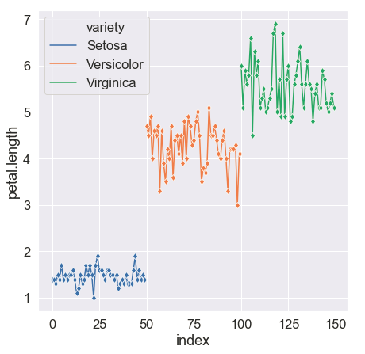
Advanced data visualization using seaborn
Performing univariate analysis with Seaborn
The goal of EDA is simple — get to know your dataset at the deepest level possible.
Becoming intimate with the data and learning its relationships between its variables is an absolute must.
Image Source:https://miro.medium.com/max/460/1*3AATuqbjcp3xMiTkuWwNPw.png
Notes:
Continuing from the last slide:
Title - Subtopic
Subtitle - Subtopic of Subtopic
Body - Description

Slide 30
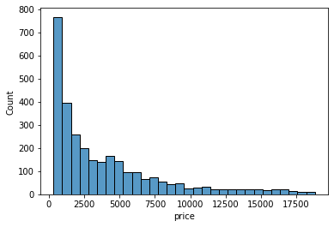
Advanced data visualization using seaborn
Creating histograms in Seaborn
Now, we create our first plot, which is a histogram:
sns.histplot(x=sample["price"])
Image Source:https://blog.logrocket.com/wp-content/uploads/2021/11/histogram-count.png
Notes:
Continuing from the last slide:
Title - Subtopic
Subtitle - Subtopic of Subtopic
Body - Description

Slide 31
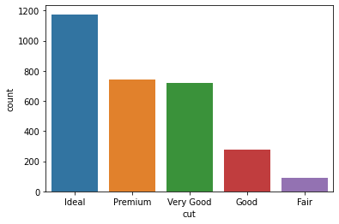
Advanced data visualization using seaborn
Creating count plots in Seaborn
The most common plot for categorical features is a countplot. Passing the name of a categorical feature in our dataset to Seaborn’s countplot draws a bar chart, with each bar height representing the number of diamonds in each category.
sns.countplot(sample["cut"])
Image Source:https://blog.logrocket.com/wp-content/uploads/2021/11/dataset-color.png
Notes:
Continuing from the last slide:
Title - Subtopic
Subtitle - Subtopic of Subtopic
Body - Description

Slide 32
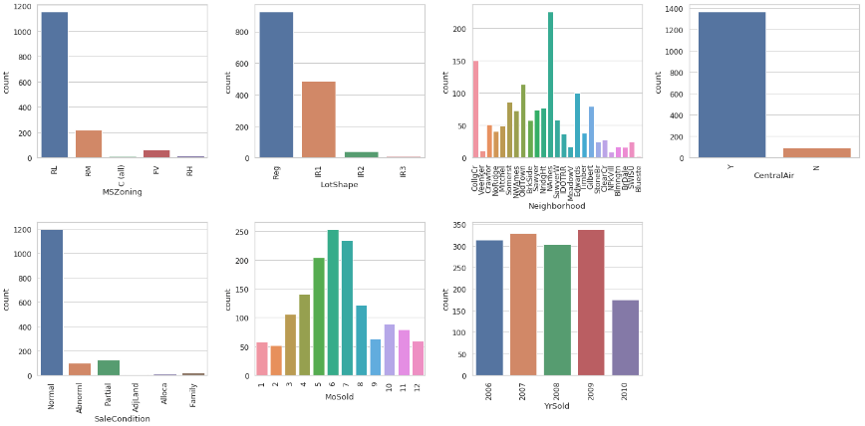
Advanced data visualization using seaborn
Performing bivariate analysis with Seaborn
Now, let’s look at the relationships between two variables at a time.
Let’s start with the connection between diamond carats and price.
Image Source:https://miro.medium.com/max/1400/1*cIOI1p56qlHaLAbb6MxrKg.png
Notes:
Continuing from the last slide:
Title - Subtopic
Subtitle - Subtopic of Subtopic
Body - Description

Slide 33
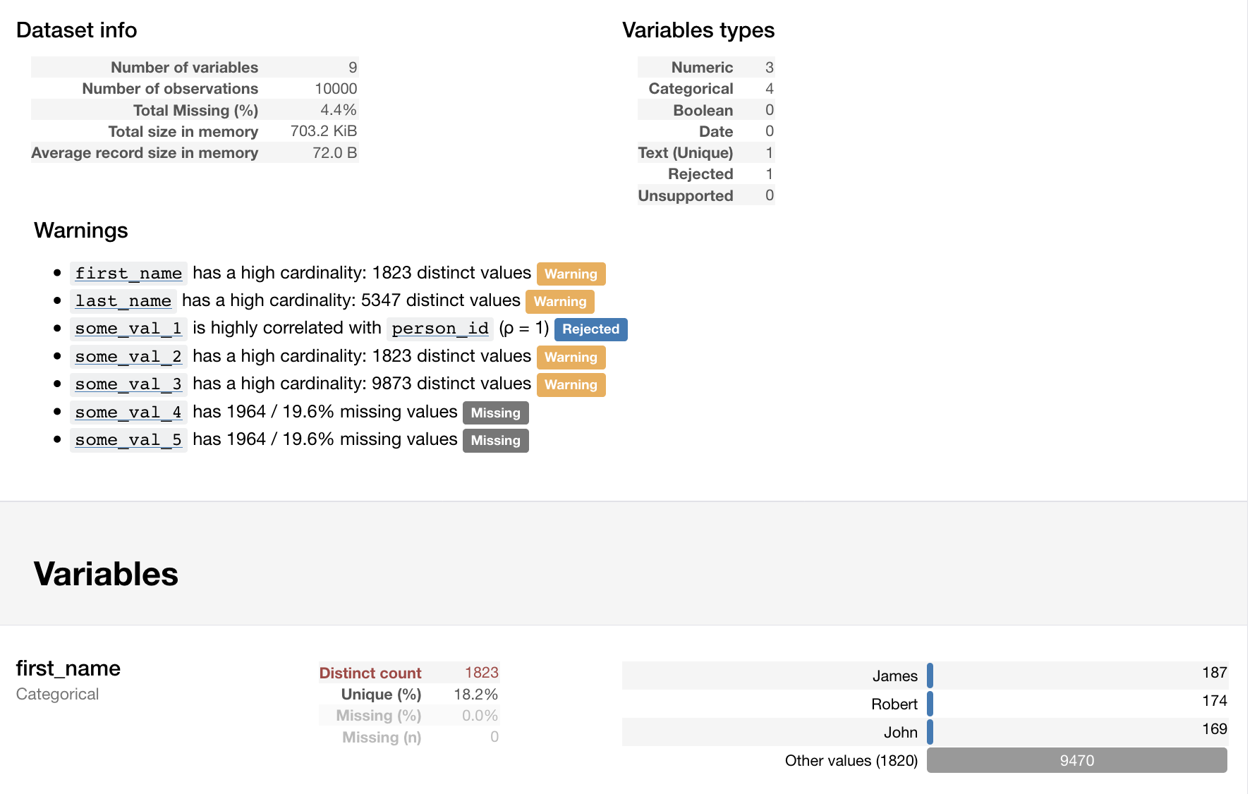
Pandas profiling for report generation
What is Pandas Profiling
Pandas Profiling is an open-source python library, which allows you to do your EDA very quickly.
By the way, it also generates an interactive HTML report, which you can show to anyone.
Image Source:http://www.leehonan.com/content/images/2018/10/Screen-Shot-2018-10-28-at-5.43.26-pm.png
Notes:
Continuing from the last slide:
Title - Subtopic
Subtitle - Subtopic of Subtopic
Body - Description

Slide 34
Pandas profiling for report generation
What is Pandas Profiling
These are some of the things you get in your report:
Type inference
Essentials
Quantile statistics
Descriptive statistics
Most frequent values
Histogram
Image Source:http://www.leehonan.com/content/images/2018/10/Screen-Shot-2018-10-28-at-5.43.26-pm.png
Notes:
Continuing from the last slide:
Title - Subtopic
Subtitle - Subtopic of Subtopic
Body - Description

Slide 35

Pandas profiling for report generation
How to install Pandas Profiling
First of all, you need to install the package.
#installing Pandas Profiling
!pip install https://github.com/pandas-profiling/pandas-profiling/archive/master.zip -q
Image Source:https://miro.medium.com/max/1400/1*qoT2rIJyQ7qD_aCE9naqGw.jpeg
Notes:
Continuing from the last slide:
Title - Subtopic
Subtitle - Subtopic of Subtopic
Body - Description

Slide 36
Pandas profiling for report generation
How to install Pandas Profiling
Then import both pandas and panda_profiling.
We will be using the Titanic dataset to complete our analysis so import that as well.
After you import it, you should always take a look at your dataset and then merely link report to it:
Image Source:https://miro.medium.com/max/1400/1*qoT2rIJyQ7qD_aCE9naqGw.jpeg
Notes:
Continuing from the last slide:
Title - Subtopic
Subtitle - Subtopic of Subtopic
Body - Description

Slide 37
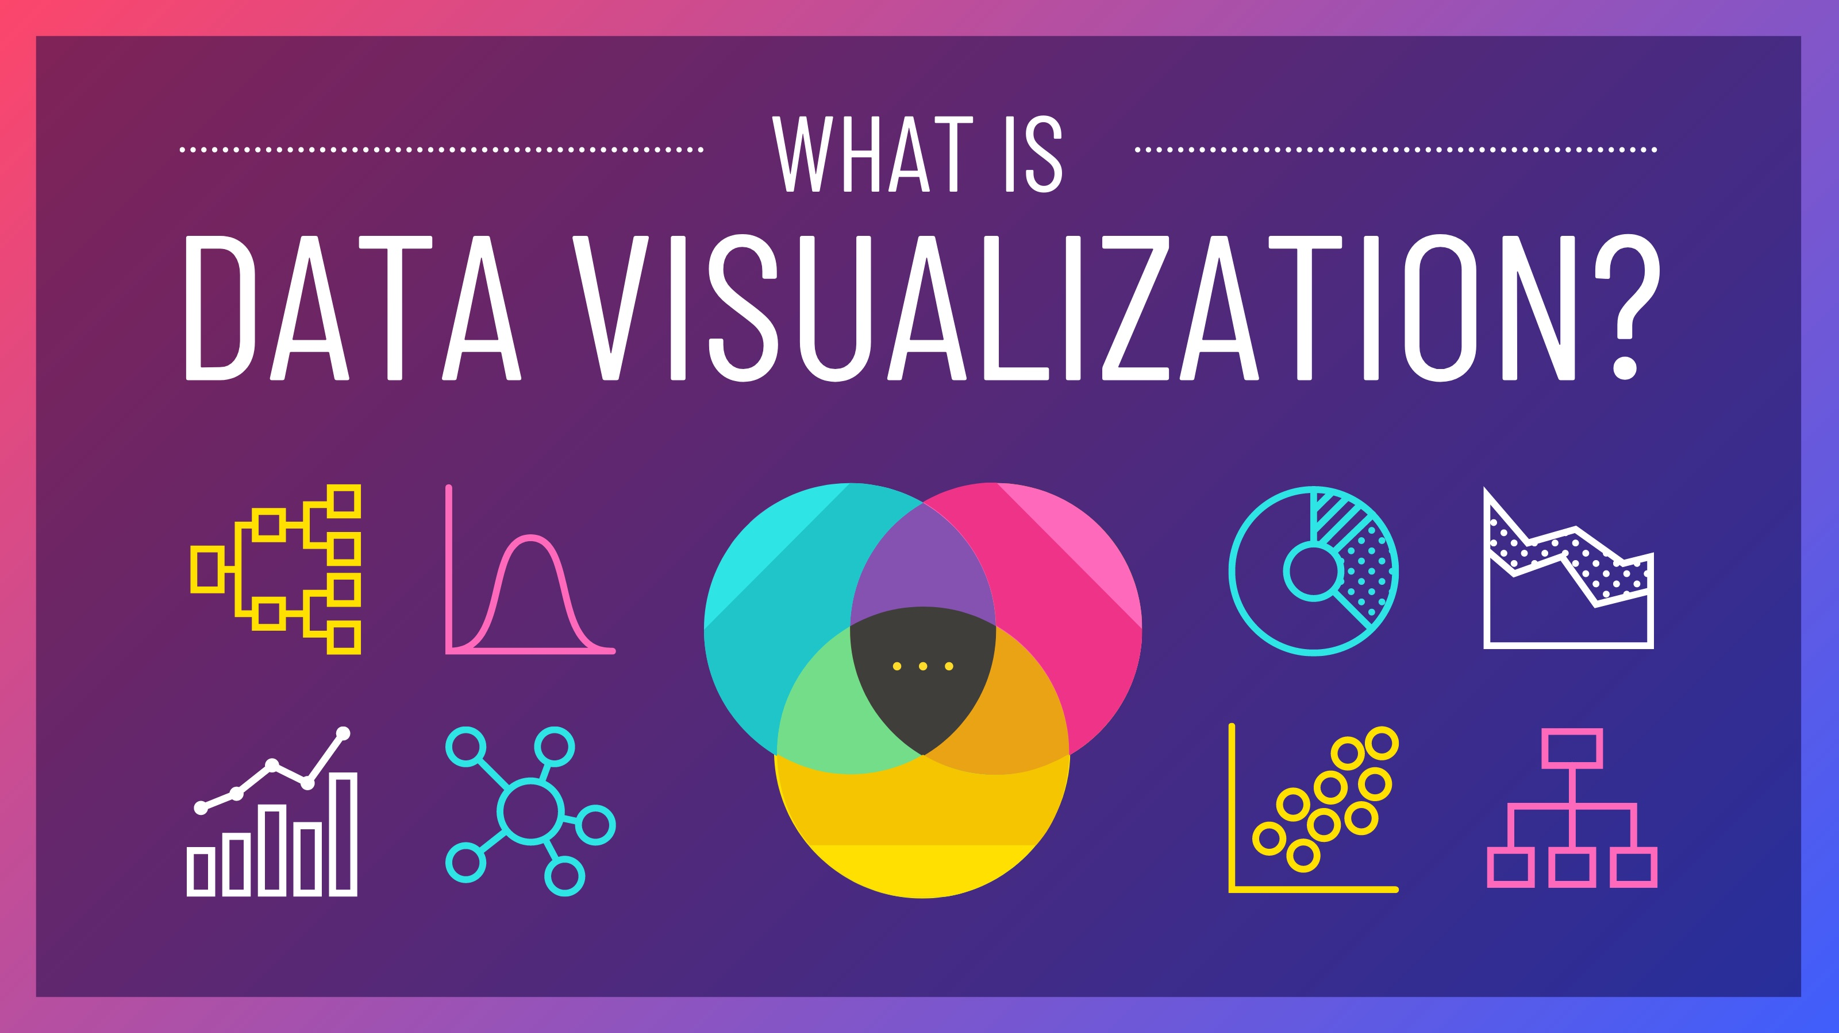
Need for data visualization
What is Data Visualization?
Data visualization gives us a clear idea of what the information means by giving it visual context through maps or graphs.
This makes the data more natural for the human mind to comprehend and therefore makes it easier to identify trends, patterns, and outliers within large data sets.
Image Source:https://venngage-wordpress.s3.amazonaws.com/uploads/2020/06/What-is-Data-Visualization-Blog-Header.jpg
Notes:
Continuing from the last slide:
Title - Subtopic
Subtitle - Subtopic of Subtopic
Body - Description

Slide 38
Need for data visualization
Why is Data Visualization Important?
Data visualization uses visual data to communicate information in a manner that is universal, fast, and effective.
This practice can help companies identify which areas need to be improved, which factors affect customer satisfaction and dissatisfaction, and what to do with specific products.
Image Source:https://i.ytimg.com/vi/VyhLRJVoIrI/maxresdefault.jpg
Notes:
Continuing from the last slide:
Title - Subtopic
Subtitle - Subtopic of Subtopic
Body - Description

Slide 39
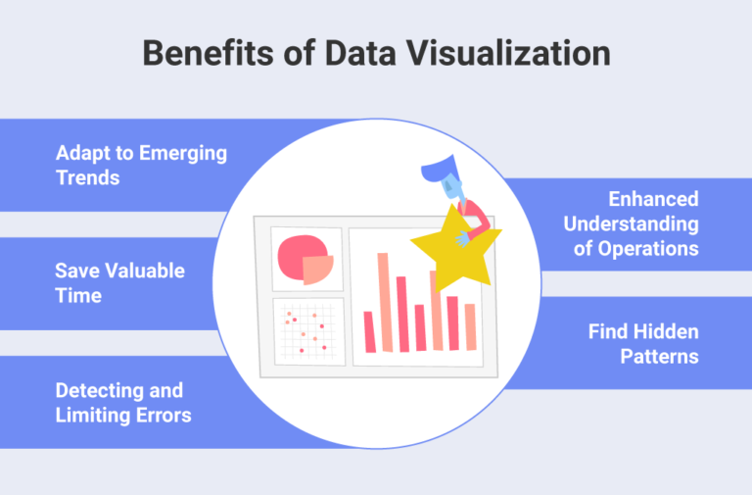
Need for data visualization
What Are The Benefits of Data Visualization?
Data visualization positively affects an organization’s decision-making process with interactive visual representations of data.
Businesses can now recognize patterns more quickly because they can interpret data in graphical or pictorial forms.
Image Source: https://cdn.slingshotapp.io/wp-content/uploads/2021/09/slingshot-Benefits-of-Data-Visualization-768x505.png
Notes:
Continuing from the last slide:
Title - Subtopic
Subtitle - Subtopic of Subtopic
Body - Description

Slide 40
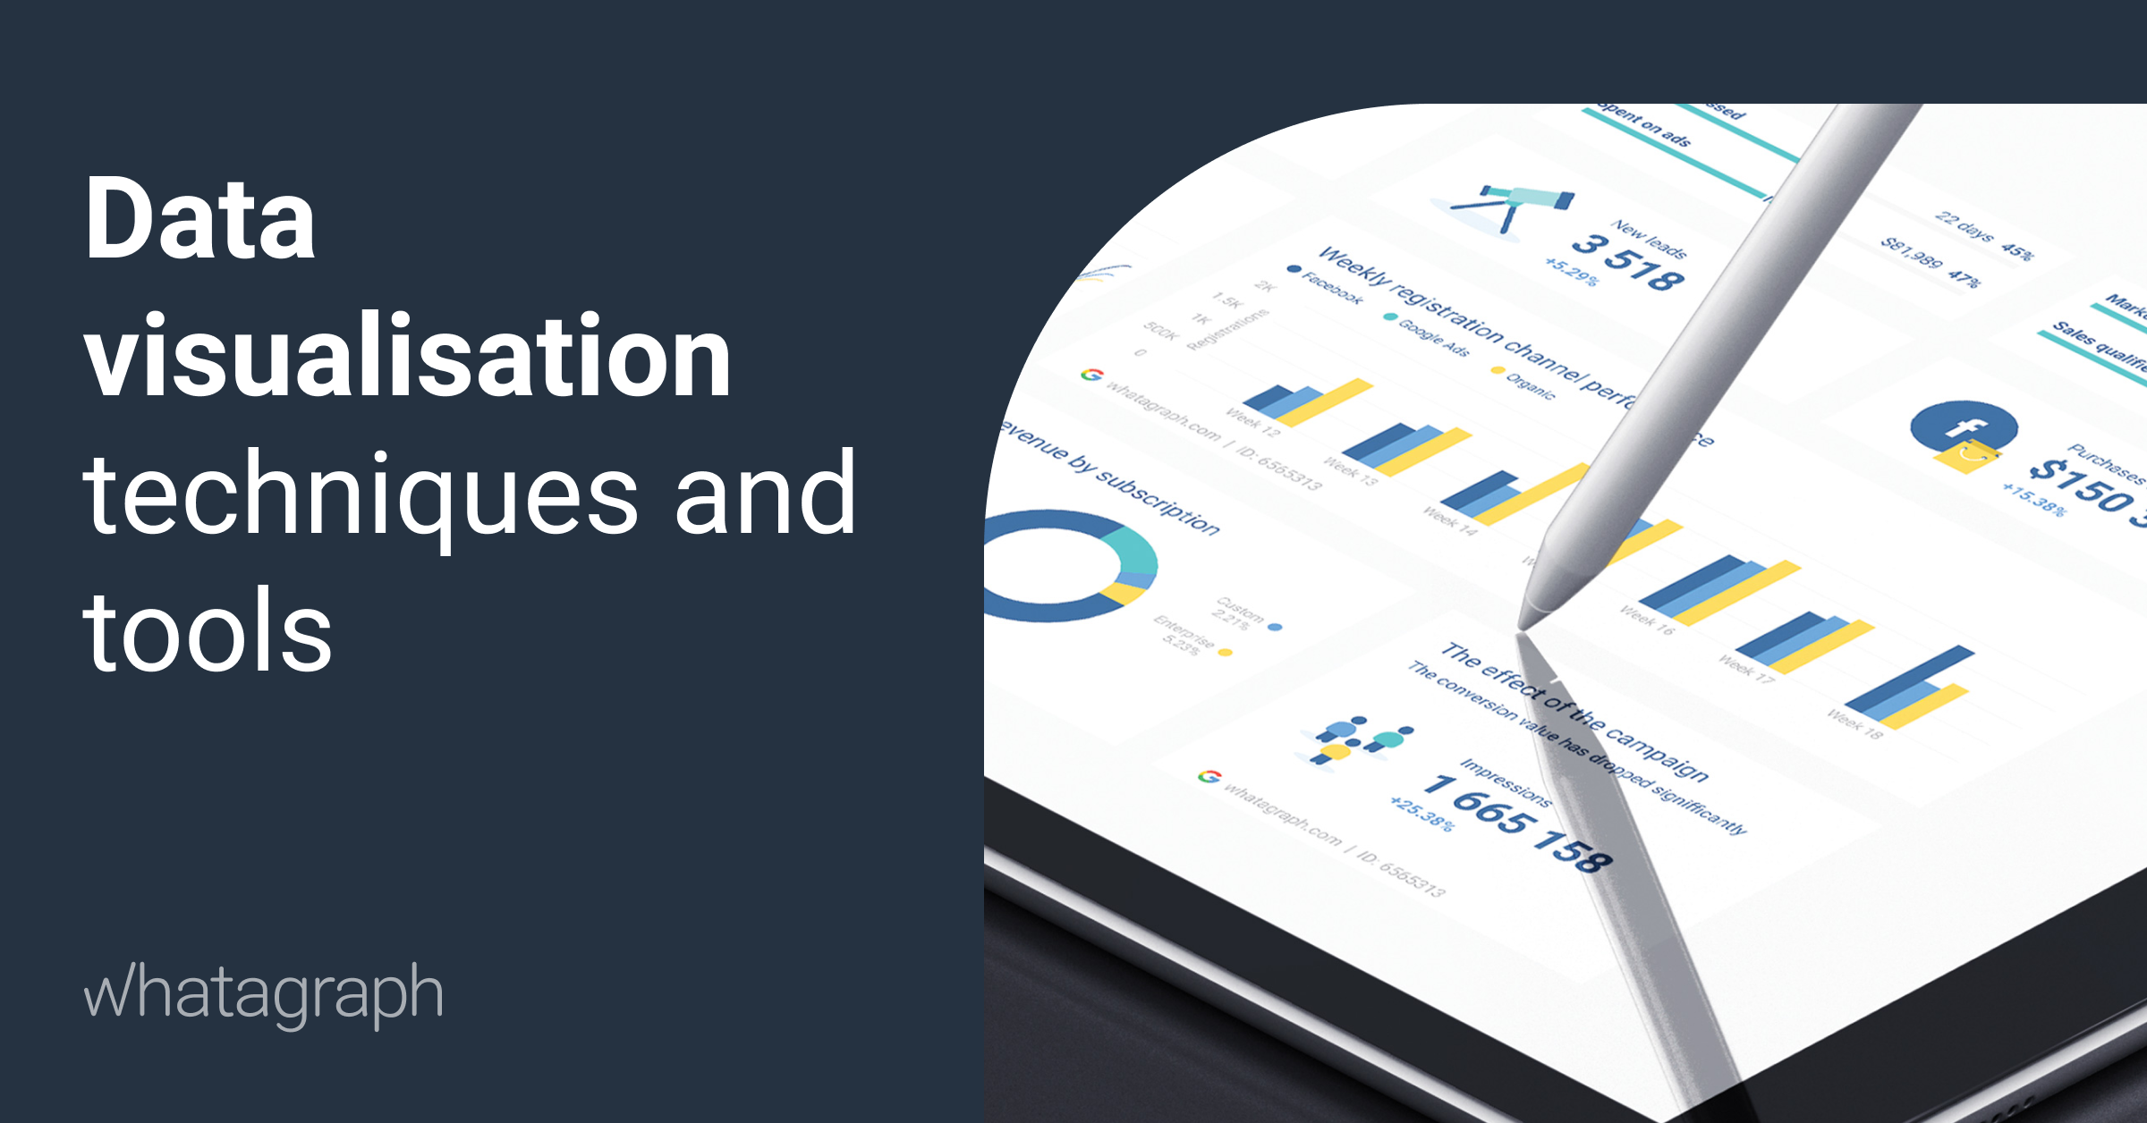
Need for data visualization
Which Data Visualization Techniques are Used?
There are many different methods of putting together information in a way that the data can be visualized.
Depending on the data being modeled, and what its intended purpose is, a variety of different graphs and tables may be utilized to create an easy to interpret dashboard.
Image Source:https://cdn.whatagraph.com/blog/data-visualisation-techniques.png
Notes:
Continuing from the last slide:
Title - Subtopic
Subtitle - Subtopic of Subtopic
Body - Description

Slide 41
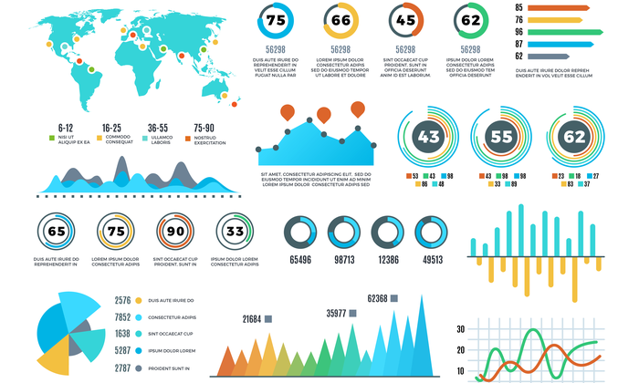
Need for data visualization
Who Uses Data Visualization?
Data visualization is used across all industries to increase sales with existing customers and target new markets and demographics for potential customers.
Image Source:https://neilpatel.com/wp-content/uploads/2021/03/Data-Visualization_Featured-Image-1.png
Notes:
Continuing from the last slide:
Title - Subtopic
Subtitle - Subtopic of Subtopic
Body - Description

